Slide 1
Information Security Awareness Campaign
Physical Security
© Copyright aeCERT 2021

Slide 2
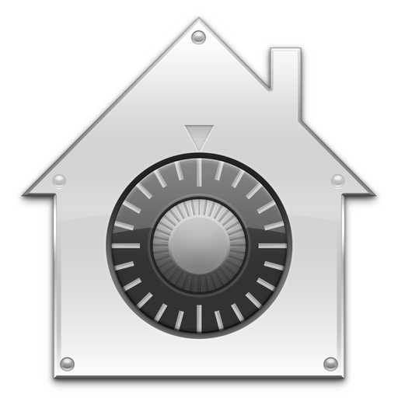
Physical Security
01
You have latest security software
02
You backup your data
03
You keep your system updated
Does that mean your information is secured and protected?
No, you need to consider the physical security of your information.
Notes:
Most of us think that cyber attacks are the only risk our information will face, but physical security is also a source of risk.
Even though physical attacks are rare but they have a huge damaging effect.

Slide 3
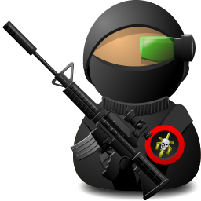
Physical Security Threats
External Physical Threats
Fire
Flooding
Earthquake
Internal Physical Threats
Electrical Interruption
Human Physical Threats
Theft
Sabotage
Spying
Errors
Notes:
You can have an Antivirus and a firewall and an IDS and an encrypted hard-drive and 12 character alphanumeric password, but if you leave your desk drawers unlocked that contains sensitive documents, or if you leave your printouts with privileged information unattended on the common printer, it only takes a few seconds for a determined attacker to bypass your million dollar digital security measures and get access to your valuable information.

Slide 4
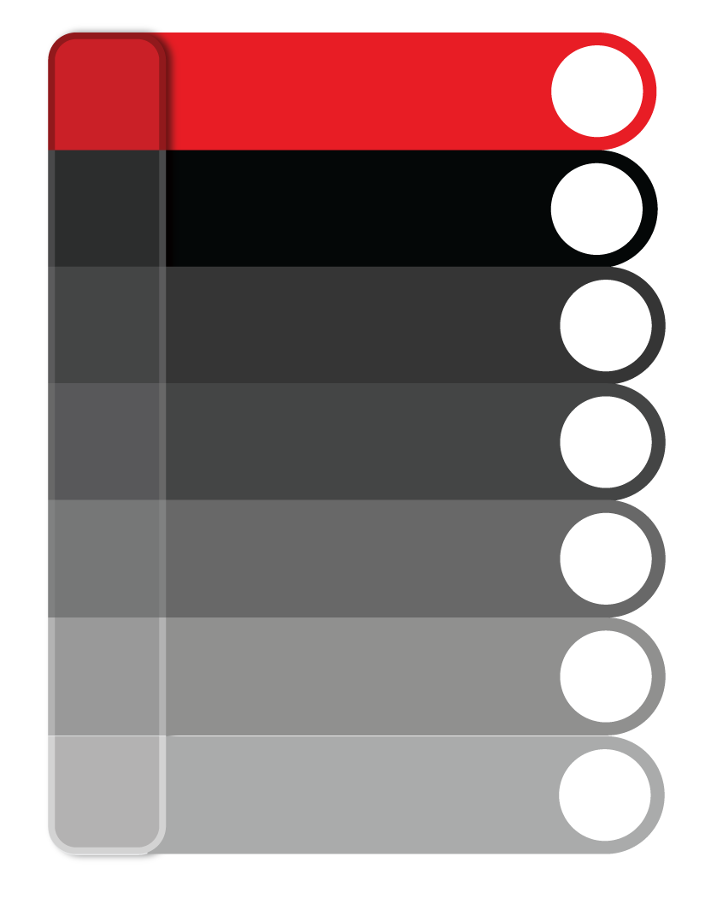
Physical Security Threats
Aspects we don’t usually consider as threats to the organization
01
Trash
02
People we consider trusted, such as Janitors, Repairmen.
03
Unlocked computers, devices, doors, cabinets
04
Documents left on a desk
05
Documents left at the scanner or the printer
Notes:
You think you are safe, think again!

Slide 5
Scenario 1: Dumpster Diving
You have some documents that you no longer need
01
02
You throw these documents in the trash
Those documents contained sensitive information and unauthorized person got access to it
Someone came and looked at your trash and took those documents
03
04
Notes:
Your trash contains a goldmine of information for someone who is really looking for it. Think of the half-printed and discolored papers you discard without shredding. They might not have printed correctly, but an attacker is usually not so interested in the aesthetics.

Slide 6
Scenario 1: Dumpster Diving
Throws confidential documents in trash
Searches trash and finds confidential information
Employee
Attacker
Trash Can
Notes:
Shred your documents with privileged information manually or using a shredder before you discard it. It also includes physically destroying CDs in a shredder. Think of how often you discard a CDR or DVD / DVD-R without physically destroying it simply because it does not work anymore.
If it has any valuable information, it is highly recommend to use a shredder to dispose the CDs / DVDs

Slide 7
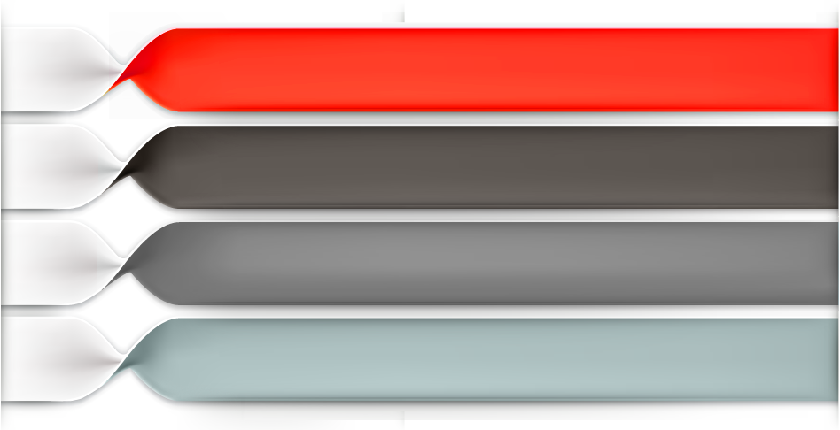
Scenario 2: Strangers
01
The janitor is cleaning the office as usual, so you don’t think he is harmful
02
You leave your office unattended
03
The janitor has access to your sensitive documents, and he took some important documents
04
That person wasn’t the janitor but a spy from a competitor company
05
These documents went to a competitor company
Notes:
Cleaners, janitors, peons and messengers have access to even highly sensitive areas due to their nature of work. It is therefore easier for an attacker to pose as one and get access.
It is therefore recommended that you lock your screen when you leave your desk and keep your sensitive documents and media in locked cabinets. Do not write passwords and do not leave it somewhere close to your work computers.

Slide 8
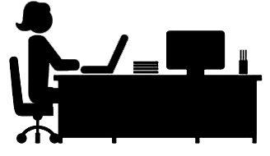
Scenario 2: Strangers
Employee leaves office and janitor accesses her sensitive files
Notes:
It is highly recommended that you lock your screen when you leave your desk. Many companies have an auto screen lock policy in which the computers which are unused for 3 minutes or more are automatically locked.
Keep your sensitive documents and media in locked cabinets. Do not write passwords and do not leave it somewhere close to your work computers or in trash.

Slide 9
Tailgating Attack
You are entering your organization through the locked door using your access card
01
02
Someone is behind you and just followed you in
03
This person had access to the organization without using his access card
04
That was a stranger that just followed you to have access to the organization.
Notes:
Just like in the cyber world, one of the simplest ways for a criminal to gain access in the physical world is to pretend to be something or someone you trust.
For example, let’s say a criminal wanted to break into our building and steal our information. One of the simplest ways to do this would not actually break into the building at night, but simply walk into it during the day. They can do this by pretending to be someone we trust, such as the repairman for the telephone or the copier machine.

Slide 10
Crime Prevention Through Environmental Design
01
Crime Prevention Through Environmental Design (CPTED) is an approach enforced by organizations to minimize the chances of crime.
02
The CPTED model helps organizations devise a plan to create security zones with different security levels.
03
CPTED implements three major protection strategies which are:
1
Natural Access Control
2
Natural Surveillance
3
Natural Territorial Reinforcement

Slide 11
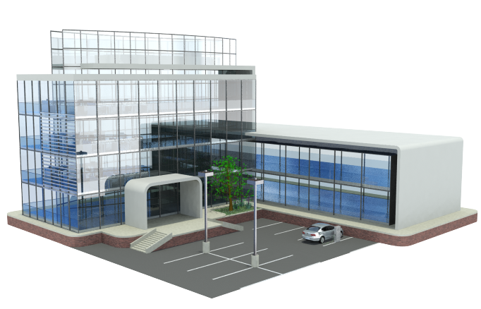
CCTV Cameras
Security Alarms
Walls
Security Officials
Biometric Devices
Bicycle Paths
Windows
Sidewalks

Slide 12
Perimeter Security
1
Perimeter security prevents unauthorized access to a location.
2
Perimeter security should be implemented in a facility in two modes i.e. during office hours and after office hours (the protocols for both will be different).
3
Perimeter security works best if it
is implemented using layered
defense approach.
Notes:
The aim of implementing perimeter security is that it helps in keeping unauthorized personnel away from the facility. Using layered defense approach makes it difficult for criminals to gain access to a valuable assets.

Slide 13
Perimeter Security
Perimeter security contains following controls:
1
Facility Access Control
2
Personnel Access Controls
3
External Boundary Protection Mechanisms
4
Intrusion Detection Systems
5
Security Officers

Slide 14
How to Protect Your Organization
1
Securely dispose off any media (papers, devices, systems, etc.) containing confidential information.
2
Question people that don’t have an identification card, ask for their identification before you let them access sensitive areas.
3
Keep confidential documents off your desk.
4
Be careful from “piggybacking” or “tailgating “, this is when someone follows you closely through a locked door.

Slide 15
How to Protect your Organization
5
Lock your computer when you are away from your desk
6
Don’t leave sensitive documents on the scanner or the printer
7
Don’t leave your laptops and devices unattended and unlocked

Slide 16
How to Ensure Physical Security
Every employ or visitor should have an
Identification card/badge
Sensitive areas should be monitored and have
restricted access
Employees should only be able to use their access cards during official
work hours
A physical security policy should be enforced in the organization

Slide 17
Questions
© Copyright aeCERT 2021
Notes:
Be sure attendees know how to contact you. We also recommend you hand out business cards and perhaps even a newsletter or fact sheet with additional information, including your contact info.

